Slide 1
WPF Workshop – Day 2
Objectives:
Resources, Styles and Templates
Triggers and Visual States
Converters, Events and Custom Controls
Troubleshooting and Debugging
Data Binding Basics and MVVM

Slide 2
Resources

Slide 3
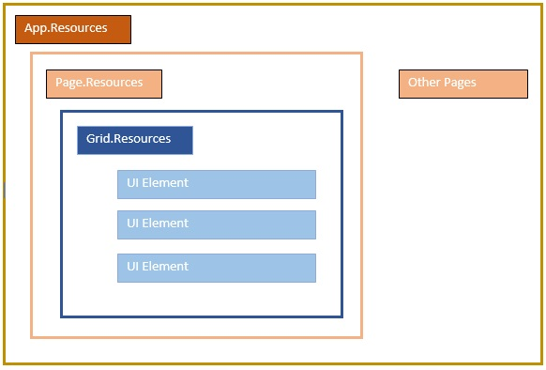
What is Xaml Resources
A resource is an object that can be reused in different places in your app. Examples of resources include brushes and styles. This overview describes how to use resources in Extensible Application Markup Language (XAML). You can also create and access resources by using code.

Slide 4
<Window.Resources>
<SolidColorBrush x:Key="MyBrush" Color="#05E0E9"/>
<Style TargetType="Border">
<Setter Property="Background" Value="#4E1A3D" />
<Setter Property="BorderThickness" Value="5" />
<Setter Property="BorderBrush">
<Setter.Value>
<LinearGradientBrush>
<GradientStop Offset="0.0" Color="#4E1A3D"/>
<GradientStop Offset="1.0" Color="Salmon"/>
</LinearGradientBrush>
</Setter.Value>
</Setter>
</Style>
<Style TargetType="TextBlock" x:Key="TitleText">
<Setter Property="FontSize" Value="18"/>
<Setter Property="Foreground" Value="#4E87D4"/>
<Setter Property="FontFamily" Value="Trebuchet MS"/>
<Setter Property="Margin" Value="0,10,10,10"/>
</Style>
<Style TargetType="TextBlock" x:Key="Label">
<Setter Property="HorizontalAlignment" Value="Right"/>
<Setter Property="FontSize" Value="13"/>
<Setter Property="Foreground" Value="{StaticResource MyBrush}"/>
<Setter Property="FontFamily" Value="Arial"/>
<Setter Property="FontWeight" Value="Bold"/>
<Setter Property="Margin" Value="0,3,10,0"/>
</Style>
</Window.Resources>
<Border>
<StackPanel>
<TextBlock Style="{StaticResource TitleText}">
Title</TextBlock>
<TextBlock Style="{StaticResource Label}">
Label</TextBlock>
<TextBlock HorizontalAlignment="Right" FontSize="36"
Foreground="{StaticResource MyBrush}"
Text="Text" Margin="20" />
<Button HorizontalAlignment="Left" Height="30"
Background="{StaticResource MyBrush}" Margin="40">
Button</Button>
<Ellipse HorizontalAlignment="Center" Width="100"
Height="100"Fill="{StaticResource MyBrush}" Margin="10" />
</StackPanel>
</Border>

Slide 5
Other Resource Types
You Can also define any CLR types in Xaml Resources for Reuse, but it is not as common as styles and color
<Page
x:Class="MSDNSample.MainPage"
xmlns="http://schemas.microsoft.com/winfx/2006/xaml/presentation"
xmlns:x="http://schemas.microsoft.com/winfx/2006/xaml">
<Page.Resources>
<x:String x:Key="greeting">Hello world</x:String>
<x:String x:Key="goodbye">Goodbye world</x:String>
</Page.Resources>
<TextBlock Text="{StaticResource greeting}" Foreground="Gray" VerticalAlignment="Center"/>
</Page>

Slide 6
Styles

Slide 7
Motivation
Duplicate XAML values are error prone and difficult to maintain
<StackPanel Background="#FFFFFF"> <TextBlock Foreground="#00FF00" FontSize="16.5" ... /> <TextBox Background="#FFFFFF" ... /> <Border Background="#00FF00" ... /> <Button Background="#00FF00" FontSize="16.5" ... />
</StackPanel>
Common to use the same colors and sizes across the UI
Notes:
Duplicate values often occur in XAML for things that define the look of the UI like fonts, sizes, and colors.
Duplicate XAML is bad:
difficult to update values in multiple places
hard to achieve consistency (e.g. if you have 20 pages in your app, it's easy to accidentally use the wrong color or size on one of them).

Slide 8
Motivation [repeated code]
Resources let you avoid duplicate values, but you still have to set each property individually which creates clutter and yields repeated code
<Button
Background ="{StaticResource highlightColor}" BorderBrush ="{StaticResource edgeColor}" BorderThickness="{StaticResource edgeSize}" Foreground ="{StaticResource textColor}" Content ="OK" />
OK
The property
settings must
be repeated
on each view
<Button
Background ="{StaticResource highlightColor}" BorderBrush ="{StaticResource edgeColor}" BorderThickness="{StaticResource edgeSize}" Foreground ="{StaticResource textColor}" Content ="Cancel" />
Cancel
Notes:
Resources are great to avoid hardcoded, duplicate values in your XAML.
However, they can be tedious to apply. Each property value needs to be assigned individually which yields cluttered, verbose XAML.

Slide 9
Motivation [efficiency]
Resource lookup can increase the startup time of your app since the lookup takes longer than assigning a literal value
<Button
Foreground="{StaticResource textColor}"
... />
<Button
Foreground="White"
... />
Slower
Faster
Notes:
Users are sensitive to startup time so it is generally considered good practice to minimize the time it takes for your UI to appear.
Resource lookup is fast; however, it still takes longer than assigning a hardcoded value that requires zero lookup.

Slide 10
What is a Setter?
A Setter is a container for a property→value pair
<Setter Property=“Foreground" Value="White" />
A bindable
property
A value appropriate
for the property
Notes:
Setter is a simple library class that stores two things: property and value.
It is analogous to an assignment statement since it encapsulates the left-hand-side and the value that gets assigned.
The types are:
Property is a BindableProperty
Value is object

Slide 11
What is a Style?
A Style is a collection of setters for a particular type of view
TargetType must be set (or runtime exception)
<Style TargetType="Button"> <Setter Property="Background" Value="#2A84D3" /> <Setter Property="BorderBrush" Value="#1C5F9B" /> <Setter Property="BorderThickness" Value="3" /> <Setter Property=“Foreground" Value="White" />
</Style>
The properties must be members of the
TargetType class (or runtime exception)
Notes:
A Style is a way to group related property settings.
The Style must be targeted at a specific type of UI view and the properties in that Style must be part of that view type. For example, you cannot create a Style targeted at Label and include a setter for BorderWidth since that property is not part of Label.

Slide 12
Styling in WPF and XAML
Order | Description
1 | Control Level Defining a style on control level can only be applied to that particular control. But setting on control level will override all the stylings in order below.
2 | Layout Level Defining a style on any layout level will make it accessible by that layout and its child elements only. And it will override window and application level.
3 | Window Level Defining a style on a window level can make it accessible by all the elements on that window only.
4 | Application Level Defining a style on app level can make it accessible throughout the entire application. It is helpful to define global styles in this level that will define application branding, look and feel and overall theme but any other levels can override styles defined here.

Slide 13
Styles as Resources
Styles are shareable, so they are generally defined as Resources
<Application.Resources> <ResourceDictionary>
<Style x:Key="MyButtonStyle" TargetType="Button"> ...
</Style> </ResourceDictionary> </Application.Resources>
Define in a
dictionary
Notes:
You can apply the same Style to many different control instances.
In other words, a Style is something that can be shared so it is a natural candidate to define in a resource dictionary.

Slide 14
Using a Style
Styles are set on a control through the Style property, this applies all the setters in the style to that control
<Button Content="OK" Style="{StaticResource MyButtonStyle}" />
<Button Content="Cancel" Style="{StaticResource MyButtonStyle}" />
The Style property is defined
in the VisualElement base
class so it is available in all views
Notes:
You load a Style by assigning to the Style property. The assignment causes each of the Setters to be applied to the target.
Using a Style has two nice benefits:
The resulting XAML is cleaner. There is just one property setting instead of several individual settings.
It encourages consistency. If you assign individual properties to many controls over multiple pages, it is easy to miss one or use inconsistent values.
The VisualElement class defines a property named Style of type Style. Most controls inherit from VisualElement so the property is widely available throughout the inheritance hierarchy of controls.
You can use DynamicResource to assign to the Style property.

Slide 15
Combining Styles and Resources
Can use a resource as the Value for a setter, this lets it share a value with other styles
<Color x:Key="bgColor">White</Color> <Color x:Key="fgColor">Black</Color>
<Style TargetType="Button" x:Key="AllButtons"> <Setter Property="Background" Value="{StaticResource bgColor}" />
<Setter Property="Foreground" Value="{DynamicResource fgColor}" />
... </Style>
Can use either static or dynamic lookup
Notes:
If two Styles use the same property value, you can factor the value out into a Resource and then apply the Resource in the two Setters.
This lets the Styles share a value which reduces repeated, hardcoded values.
You can use either StaticResource or DynamicResource for the Value of a Setter. The two options behave as usual for them: static will not update if the underlying Resource changes while dynamic will.

Slide 16
Implicit Styles
Styles can be automatically applied to all controls of a target type by omitting x:Key and placing the style into an accessible dictionary
<Application.Resources> <ResourceDictionary> <Style TargetType="Button"> <Setter Property="Background" Value="Blue" /> <Setter Property="Foreground" Value="Navy" />
... </Style> </ResourceDictionary>
</Application.Resources>
The target type is still specified and is matched exactly,
this style will be applied to all buttons in this page
Notes:
Normally, when you add something to a resource dictionary, you must specify both key and value.
There is a special case with Styles. A Style without a key has a special meaning, it becomes an implicit Style that is automatically applied to every object of its TargetType.
The matching of implicit style to control requires an exact match for the types. That is, an implicit Style with a TargetType of VisualElement will not be applied to a Button since their types do not match exactly.
ResourceDictionary has an Add method that is dedicated to implicit Styles. It generates the dictionary key internally. The source code is:
public void Add(Style implicitStyle)
{
this.Add(implicitStyle.TargetType.FullName, implicitStyle);
}

Slide 17
Overriding a setter
Styles provide the default values, explicit property values on the control are applied after the style and take precedence
<Style x:Key="MyButtonStyle" TargetType="Button"> <Setter Property="Background" Value="Red" /> </Style>
<Button
Style="{StaticResource MyButtonStyle}"
Background="Blue"
Text="Cancel" ... />
Cancel
Value set directly overrules the style value
Background is blue, not red
Notes:
Suppose you have a property setting in a Style.
[Animation step]
You apply the Style to a control, but then explicitly set that same property directly on the control.
[Animation step]
The direct setting overrides the one from the Style.
[Animation step]
The property will take on the value in the direct setting.
For example:
Suppose you are considering whether to use a Style written by someone else. You don't own the Style and cannot modify it.
It could happen that the Style is almost, but not quite perfect for your needs. For example, it might have 5 Setters, 4 of which use values you want but 1 of which isn't quite right.
You can go ahead and use the Style but then add an explicit property setting to your control for the Setter that has the inappropriate value. Your explicit value will override the one in the Style.

Slide 18
Ancestor targeting
A Style can target a base type of the object to which it is applied
This style targets Control
<Style x:Key="MyVisualElementStyle" TargetType="Control"> <Setter Property="Background" Value="#2A84D3" /> </Style>
<Button Style="{StaticResource MyVisualElementStyle}" ... />
Can apply to a button since the Button
class is derived from VisualElement
Notes:
You can write a Style that targets a base class.
[Animation step]
The Style can be applied to any of the derived types.
Optional active-learning question:
Q: Which properties can you set in a Style that targets a base class?
A: Only those defined in that base type (or one of its parent types).
Note that this is a different rule than implicit Styles. With implicit Styles, the types must match exactly. That's not true here since we are using explicit application of the Style.

Slide 19

Creating a Style in code
Styles can be created in code to allow runtime customizations
var s = new Style(typeof(Button)); s.Setters.Add(new Setter {Property = Button.BackgroundProperty, Value = Color.Red}); s.Setters.Add(new Setter {Property = Button.BorderThicknessProperty, Value = 4});
Can then apply Style to a Button directly, or add it to the resources to apply in XAML
Notes:
It is possible to create a Style in code.
This is rare. It can be useful for code-generated UI or when you need the full power of code-behind to create/modify/update the Style at runtime.

Slide 20
Inheriting From Another Style
You can create a base style and Inherit other styles based on it. This way you can port styles as resource dictionaries across different applications.
<Button Command="{Binding MyCommandInViewModel, RelativeSource={RelativeSource AncestorType=Window}}">
<Button.Style>
<Style BasedOn="{StaticResource StyleFromButtonStyles}" TargetType="Button">
<Style.Triggers>
<DataTrigger Binding="{Binding SomeBool}" Value="True">
<Setter Property="Button.Content" Value="{StaticResource SomeImage}"/>
</DataTrigger>
<DataTrigger Binding="{Binding SomeBool}" Value="False">
<Setter Property="Button.Content" Value="{StaticResource SomeOtherImage}"/>
</DataTrigger>
</Style.Triggers>
</Style>
</Button.Style>
</Button>
<Window.Resources>
<ResourceDictionary>
<ResourceDictionary.MergedDictionaries>
<ResourceDictionary Source="/MyProject.Styles;component/ButtonStyles.xaml"/>
</ResourceDictionary.MergedDictionaries>
[*Your other resources can be put here*]
</ResourceDictionary>
</Window.Resources>

Slide 21
Demo:
Styles
Notes:
https://www.codeproject.com/articles/403418/lifetime-events-of-a-wpf-application

Slide 22
Templates

Slide 23
What are Templates
A template describes the overall look and visual appearance of a control. For each control, there is a default template associated with it which gives the control its appearance. In WPF applications, you can easily create your own templates when you want to customize the visual behavior and visual appearance of a control.
Connectivity between the logic and the template can be achieved by data binding. The main difference between styles and templates are listed below −
Styles can only change the appearance of your control with default properties of that control.
With templates, you can access more parts of a control than in styles. You can also specify both existing and new behavior of a control.
There are two types of templates which are most used: Control Template and Data Template

Slide 24
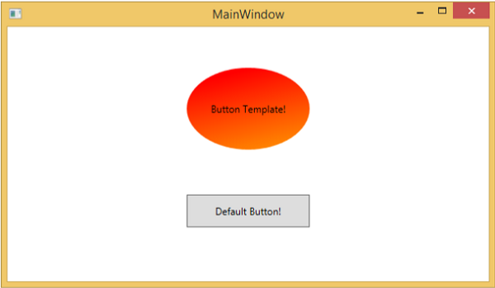
Control Template
The Control Template defines the visual appearance of a control. All of the UI elements have some kind of appearance as well as behavior, e.g., Button has an appearance and behavior. Click event or mouse hover event are the behaviors which are fired in response to a click and hover and there is also a default appearance of button which can be changed by the Control template.
<StackPanel>
<Button Content = "Round Button!"
Template = "{StaticResource ButtonTemplate}"
Width = "150" Margin = "50" />
<Button Content = "Default Button!" Height = "40"
Width = "150" Margin = "5" />
</StackPanel>

Slide 25
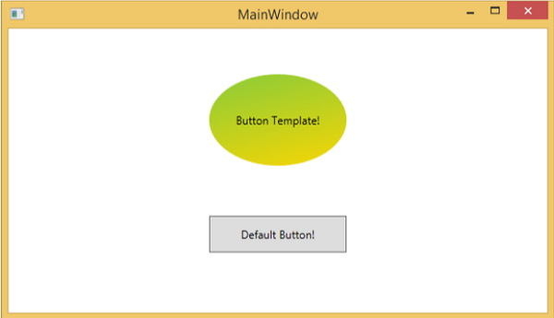

<Window.Resources>
<ControlTemplate x:Key = "ButtonTemplate" TargetType = "Button">
<Grid>
<Ellipse x:Name = "ButtonEllipse" Height = "100" Width = "150" >
<Ellipse.Fill>
<LinearGradientBrush StartPoint = "0,0.2" EndPoint = "0.2,1.4">
<GradientStop Offset = "0" Color = "Red" />
<GradientStop Offset = "1" Color = "Orange" />
</LinearGradientBrush>
</Ellipse.Fill>
</Ellipse>
<ContentPresenter Content = "{TemplateBinding Content}"
HorizontalAlignment = "Center" VerticalAlignment = "Center" />
</Grid>
…
…
<ControlTemplate.Triggers>
<Trigger Property = "IsMouseOver" Value = "True">
<Setter TargetName = "ButtonEllipse" Property = "Fill" >
<Setter.Value>
<LinearGradientBrush StartPoint = "0,0.2" EndPoint = "0.2,1.4">
<GradientStop Offset = "0" Color = "YellowGreen" />
<GradientStop Offset = "1" Color = "Gold" />
</LinearGradientBrush>
</Setter.Value>
</Setter>
</Trigger>
<Trigger Property = "IsPressed" Value = "True">
<Setter Property = "RenderTransform">
<Setter.Value>
<ScaleTransform ScaleX = "0.8" ScaleY = "0.8"
CenterX = "0" CenterY = "0" />
</Setter.Value>
</Setter>
<Setter Property = "RenderTransformOrigin" Value = "0.5,0.5" />
</Trigger>
</ControlTemplate.Triggers>
</ControlTemplate>
</Window.Resources>

Slide 26
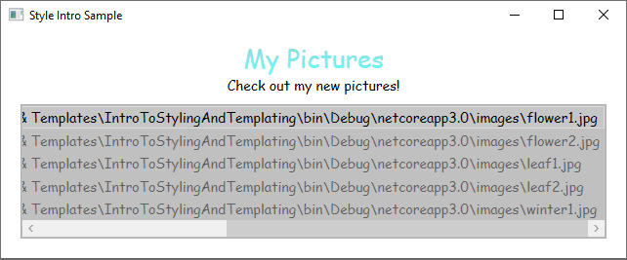
Data Template
A Data Template defines and specifies the appearance and structure of a collection of data. It provides the flexibility to format and define the presentation of the data on any UI element. It is mostly used on data related Item controls such as ComboBox, ListBox, etc.
<ListBox ItemsSource="{Binding Source={StaticResource MyPhotos}}"
Background="Silver" Width="600" Margin="10" SelectedIndex="0"/>
<Window.Resources>
<!-- .... other resources .... -->
<!--DataTemplate to display Photos as images
instead of text strings of Paths-->
<DataTemplate DataType="{x:Type local:Photo}">
<Border Margin="3">
<Image Source="{Binding Source}"/>
</Border>
</DataTemplate>
</Window.Resources>
public class Photo
{
public Photo(string path)
{
Source = path;
}
public string Source { get; }
public override string ToString() => Source;
}

Slide 27
Demo:
Templates

Slide 28
Triggers

Slide 29
What are Triggers
A trigger sets properties or starts actions, such as an animation, when a property value changes or when an event is raised. Style, ControlTemplate, and DataTemplate all have a Triggers property that can contain a set of triggers.
There are several types of triggers:
Property Triggers: Most common type of trigger.
EventTriggers and Storyboards
MultiTriggers, DataTriggers, and MultiDataTriggers

Slide 30
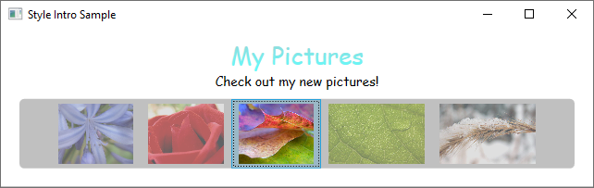
Property Trigger
A Trigger that sets property values or starts actions based on the value of a property is called a property trigger.
<Window.Resources>
<!-- .... other resources .... -->
<Style TargetType="ListBoxItem">
<Setter Property="Opacity" Value="0.5" />
<Setter Property="MaxHeight" Value="75" />
<Style.Triggers>
<Trigger Property="IsSelected" Value="True">
<Trigger.Setters>
<Setter Property="Opacity" Value="1.0" />
</Trigger.Setters>
</Trigger>
</Style.Triggers>
</Style>
</Window.Resources>
To demonstrate how to use property triggers, you can make each ListBoxItem partially transparent unless it is selected. The following style sets the Opacity value of a ListBoxItem to 0.5. When the IsSelected property is true, however, the Opacity is set to 1.0.

Slide 31
Event Trigger
<Style.Triggers>
<Trigger Property="IsSelected" Value="True">
<Trigger.Setters>
<Setter Property="Opacity" Value="1.0" />
</Trigger.Setters>
</Trigger>
<EventTrigger RoutedEvent="Mouse.MouseEnter">
<EventTrigger.Actions>
<BeginStoryboard>
<Storyboard>
<DoubleAnimation
Duration="0:0:0.2"
Storyboard.TargetProperty="MaxHeight"
To="90" />
</Storyboard>
</BeginStoryboard>
</EventTrigger.Actions>
</EventTrigger>
<EventTrigger RoutedEvent="Mouse.MouseLeave">
<EventTrigger.Actions>
<BeginStoryboard>
<Storyboard>
<DoubleAnimation
Duration="0:0:1"
Storyboard.TargetProperty="MaxHeight" />
</Storyboard>
</BeginStoryboard>
</EventTrigger.Actions>
</EventTrigger>
</Style.Triggers>
Another type of trigger is the EventTrigger, which starts a set of actions based on the occurrence of an event. For example, the following EventTrigger objects specify that when the mouse pointer enters the ListBoxItem, the MaxHeight property animates to a value of 90 over a 0.2 second period. When the mouse moves away from the item, the property returns to the original value over a period of 1 second. Note how it is not necessary to specify a To value for the MouseLeave animation. This is because the animation is able to keep track of the original value.

Slide 32
MultiTrigger
<Style.Triggers>
<Trigger Property="IsEnabled" Value="false">
<Setter Property="Background" Value="#EEEEEE" />
</Trigger>
<MultiTrigger>
<MultiTrigger.Conditions>
<Condition Property="HasItems" Value="false" />
<Condition Property="Width" Value="Auto" />
</MultiTrigger.Conditions>
<Setter Property="MinWidth" Value="120"/>
</MultiTrigger>
<MultiTrigger>
<MultiTrigger.Conditions>
<Condition Property="HasItems" Value="false" />
<Condition Property="Height" Value="Auto" />
</MultiTrigger.Conditions>
<Setter Property="MinHeight" Value="95"/>
</MultiTrigger>
</Style.Triggers>
In addition to Trigger and EventTrigger, there are other types of triggers. MultiTrigger allows you to set property values based on multiple conditions.

Slide 33
DataTrigger and MultiDataTrigger
You use DataTrigger and MultiDataTrigger when the property of your condition is data-bound.
…
<DataTemplate DataType="{x:Type c:Place}">
<Canvas Width="160" Height="20">
<TextBlock FontSize="12"
Width="130" Canvas.Left="0"
Text="{Binding Path=Name}"/>
<TextBlock FontSize="12" Width="30"
Canvas.Left="130" Text="{Binding Path=State}"/>
</Canvas>
</DataTemplate>
</Window.Resources>
<StackPanel>
<TextBlock FontSize="18" Margin="5" FontWeight="Bold"
HorizontalAlignment="Center">
Data Trigger Sample</TextBlock>
<ListBox Width="180"
HorizontalAlignment="Center" Background="Honeydew"
ItemsSource="{Binding Source={StaticResource PlacesData}}"/>
</StackPanel>
<Window.Resources>
<c:Places x:Key="PlacesData"/>
<Style TargetType="ListBoxItem">
<Style.Triggers>
<DataTrigger Binding="{Binding Path=State}" Value="WA">
<Setter Property="Foreground" Value="Red" />
</DataTrigger>
<MultiDataTrigger>
<MultiDataTrigger.Conditions>
<Condition Binding="{Binding Path=Name}" Value="Portland" />
<Condition Binding="{Binding Path=State}" Value="OR" />
</MultiDataTrigger.Conditions>
<Setter Property="Background" Value="Cyan" />
</MultiDataTrigger>
</Style.Triggers>
</Style>
…

Slide 34
Demo:
Triggers

Slide 35
Visual States

Slide 36
What is Visual State
Controls are always in a specific state. For example, when the mouse moves over the surface of a control, the control is considered to be in a common state of MouseOver. A control without a specific state is considered to be in the common Normal state. States are broken into groups, and the previously mentioned states are part of the state group CommonStates. Most controls have two state groups: CommonStates and FocusStates.
VisualState Name | VisualStateGroup Name | Description
Normal | CommonStates | The default state.
MouseOver | CommonStates | The mouse pointer is positioned over the control.
Pressed | CommonStates | The control is pressed.
Disabled | CommonStates | The control is disabled.
Focused | FocusStates | The control has focus.
Unfocused | FocusStates | The control does not have focus.

Slide 37
Visual State Manager and Groups
<ControlTemplate x:Key="roundbutton" TargetType="Button">
<Grid>
<VisualStateManager.VisualStateGroups>
<VisualStateGroup Name="CommonStates">
<VisualState Name="Normal">
<ColorAnimation
Storyboard.TargetName="backgroundElement"
Storyboard.TargetProperty=
"(Shape.Fill).(SolidColorBrush.Color)"
To="{TemplateBinding Background}"
Duration="0:0:0.3"/>
</VisualState>
<VisualState Name="MouseOver">
<ColorAnimation
Storyboard.TargetName="backgroundElement"
Storyboard.TargetProperty=
"(Shape.Fill).(SolidColorBrush.Color)"
To="Yellow"
Duration="0:0:0.3"/>
</VisualState>
</VisualStateGroup>
</VisualStateManager.VisualStateGroups>
...
By System.Windows.VisualStateManager setting on the root element of a control template, you can trigger animations when a control enters a specific state. The VisualStateManager declares which combinations of VisualStateGroup and VisualState to watch. When the control enters a watched state, the animation defined by the VisaulStateManager is started.

Slide 38
Demo:
Visual States

Slide 39
Converters

Slide 40
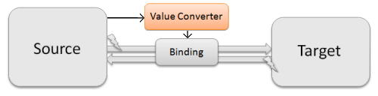
Value Converters
If you want to databind two properties that have incompatible types, you need a piece of code in between, that converts the value from source to target type and back. This piece of code is called ValueConverter. A value converter is a class, that implements the simple interface IValueConverter with the two methods object Convert(object value) and object ConvertBack(object value).
public class BoolToVisibilityConverter : IValueConverter
{
public object Convert(object value, Type targetType,
object parameter, CultureInfo culture)
{
// Do the conversion from bool to visibility
}
public object ConvertBack(object value, Type targetType,
object parameter, CultureInfo culture)
{
// Do the conversion from visibility to bool
}
}
<Window x:Class="VirtualControlDemo.Window1"
...
xmlns:l="clr-namespace:VirtualControlDemo"
...>
<Window.Resources>
<l:BoolToVisibilityConverter x:Key="converter" />
</Window.Resources>
<Grid>
<Button Visibility="{Binding HasFunction,
Converter={StaticResource converter}}" />
</Grid>
</Window>

Slide 41
Demo:
Converters

Slide 42
Events

Slide 43
Routed Events
In WPF routed event is a type of event that can invoke handlers on multiple listeners in an element tree rather than just the object that raised the event. It is basically a CLR event that is supported by an instance of the Routed Event class. It is registered with the WPF event system. RoutedEvents have three main routing strategies which are as follows −
Direct Event
Bubbling Event
Tunnel Event

Slide 44
Direct Event
A direct event is similar to events in Windows forms which are raised by the element in which the event is originated.
Unlike a standard CLR event, direct routed events support class handling and they can be used in Event Setters and Event Triggers within your style of your Custom Control.
A good example of a direct event would be the MouseEnter event.

Slide 45
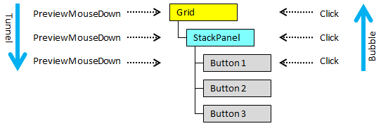
Bubbling Event
A bubbling event begins with the element where the event is originated. Then it travels up the visual tree to the topmost element in the visual tree. So, in WPF, the topmost element is most likely a window.

Slide 46
Tunnel Event
Event handlers on the element tree root are invoked and then the event travels down the visual tree to all the children nodes until it reaches the element in which the event originated.
The difference between a bubbling and a tunneling event is that a tunneling event will always start with a preview.
In a WPF application, events are often implemented as a tunneling/bubbling pair. So, you'll have a preview MouseDown and then a MouseDown event.

Slide 47
Custom Routed Events
In .NET framework, custom routed event can also be defined. You need to follow the steps given below to define a custom routed event in C#.
Declare and register your routed event with system call RegisterRoutedEvent.
Specify the Routing Strategy, i.e. Bubble, Tunnel, or Direct.
Provide the event handler.

Slide 48
Demo:
Events

Slide 49
Custom Controls

Slide 50
WPF User Control
User Controls provide a way to collect and combine different built-in controls together and package them into re-usable XAML. User controls are used in following scenarios −
If the control consists of existing controls, i.e., you can create a single control of multiple, already existing controls.
If the control doesn't need support for theming. User Controls do not support complex customization, control templates, and difficult to style.
If a developer prefers to write controls using the code-behind model where a view and then a direct code behind for event handlers.
You won't be sharing your control across applications.

Slide 51
WPF Custom Control
A custom control is a class which offers its own style and template which are normally defined in generic.xaml. Custom controls are used in the following scenarios −
If the control doesn't exist and you have to create it from scratch.
If you want to extend or add functionality to a preexisting control by adding an extra property or an extra functionality to fit your specific scenario.
If your controls need to support theming and styling.
If you want to share your control across applications.

Slide 52
WPF Custom Control Library
Perfect for making reusable WPF control collection
It can easily be shared across different projects
It can be published as nuget package for internal or external use
Most WPF third-party vendors use this style to create libraries
Project will be compiled into DLLs and other static resources
Follow these Set of guidelines:
Define Requirements
Create Project Structures
Choose the right base class
Override and Create Default Style
Add DependencyProperties
Map XML Namespace
Logical and Visual Children

Slide 53
Demo:
Custom Controls

Slide 54
Debugging and Troubleshooting
Objectives:
Debugging XAML
Debugging and Troubleshooting Performance Issues
Application Lifecycle Management

Slide 55
XAML Tools
Visual Studio Designer
XAML Debugging Toolbar
Live Visual Tree
Hot Reload
XAML Live Preview
Visual Studio Intellisense
GitHub Copilot

Slide 56
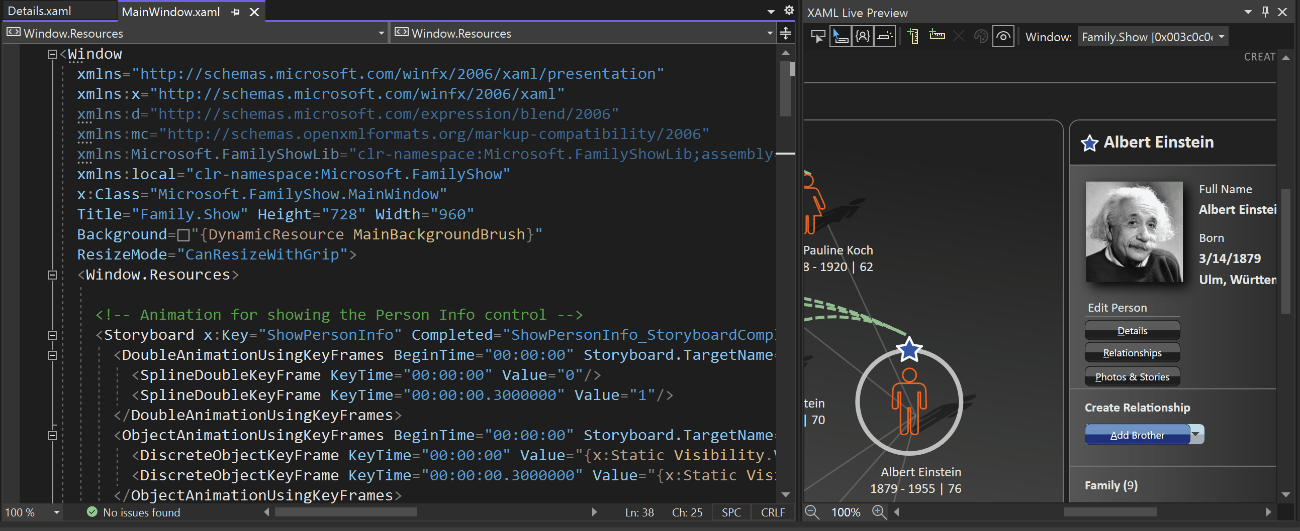

Slide 57
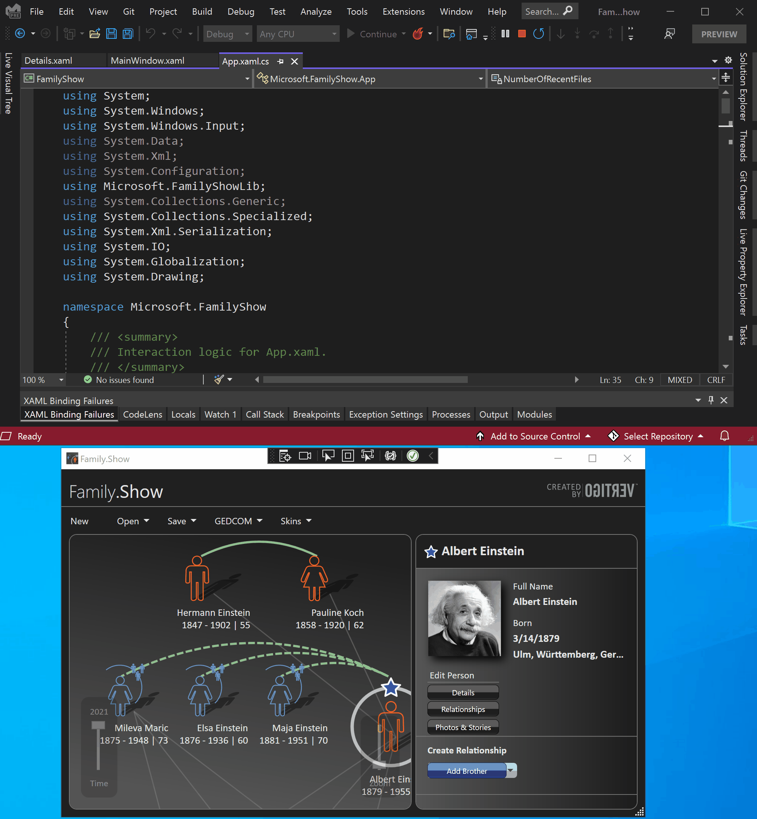

Slide 58
Debugging and Troubleshooting WPF App
Visual Studio Debugger
Visual Studio Profiler (Most Comprehensive)
Diagnostics Tools (While Debugging)
Debugging Using WinDbg (Advanced)
Collecting Telemetry Using Application Insight (Local or ..)
Collecting Telemetry and Crash Info Using App Center SDK

Slide 59
Demo:
Debugging and Troubleshooting

Slide 60
Other connected Services
Databases, APIs and Storage Options
Credential management (Local and Cloud)
Automations and Real-time communication
Cache Services with offline Capability

Slide 61
Application Lifecycle Management
App Center is a great option for Distributing, Diagnostics and Analysis of your WPF app.
OS/Platform | Build | Test | Distribute | Diagnostics | Analytics
Windows - WPF | ❌ | ❌ | ✅† | ✅ | ✅
† - In-app updates not supported for this platform.

Slide 62
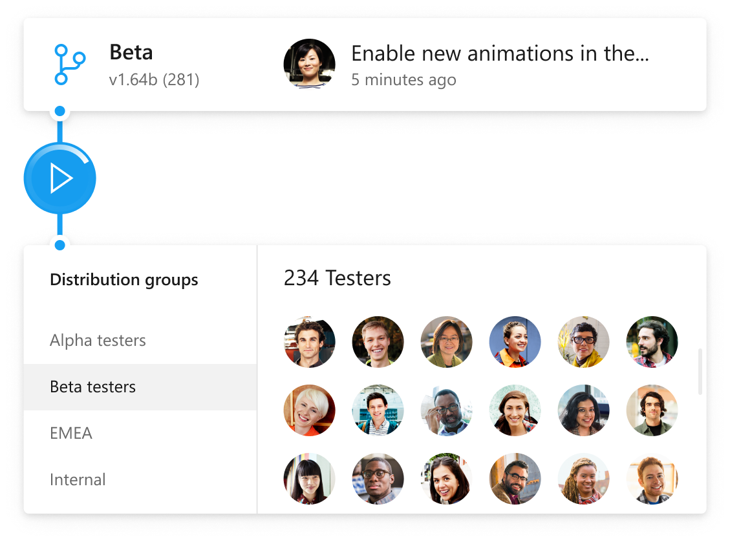
Distribution

Slide 63
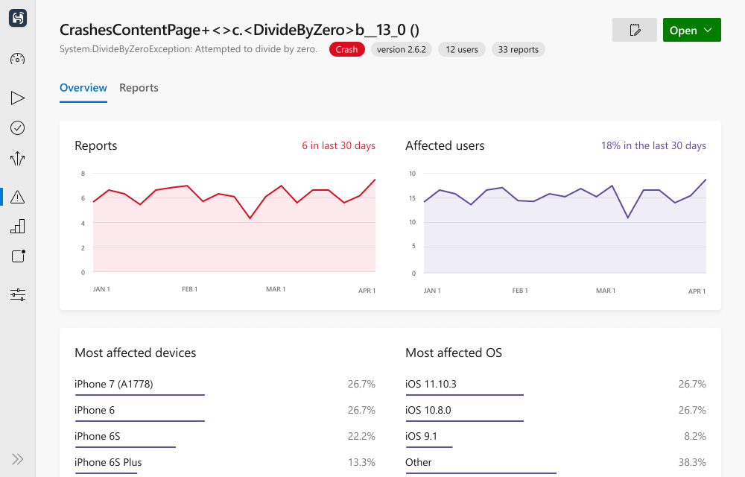
Diagnostics

Slide 64
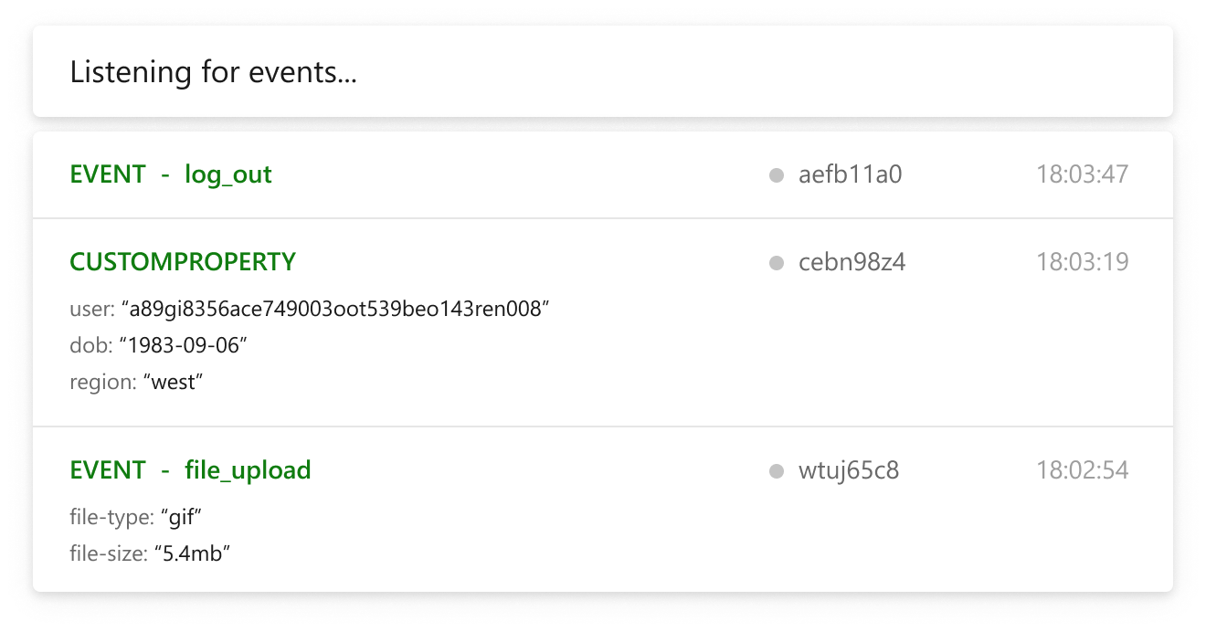
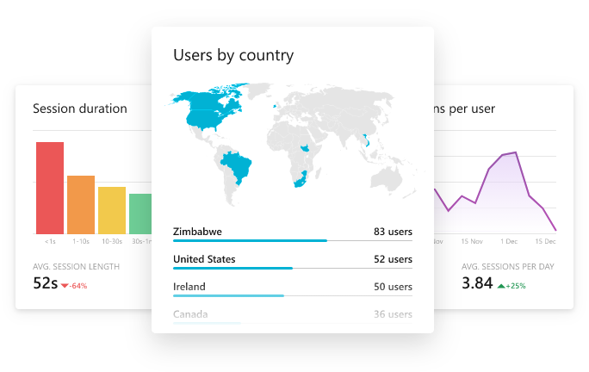
Analytics

Slide 65
Demo:
AppCenter

Slide 66
Data Binding Basics

Slide 67
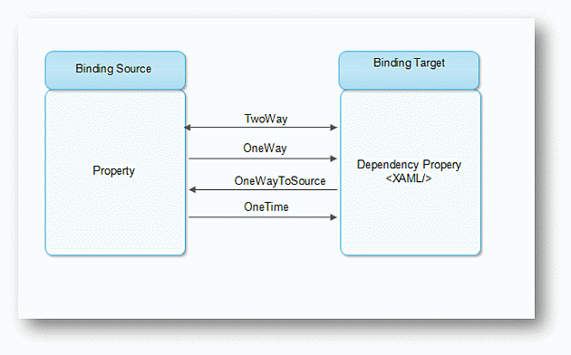
XAML Data Binding

Slide 68
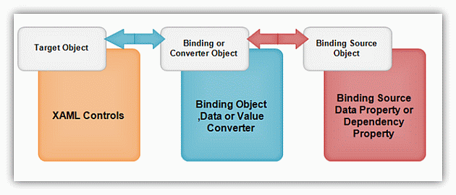
XAML Data Binding Converter

Slide 69
Data binding
Data binding can sync a source property and a target property.
A source property is a general property.
A target property is a dependency property or an attached property.
A target property
A source property
Data binding
Two-way syncing
Notes:
Data binding is a way for your app's UI to display data, and optionally to stay in sync with that data. Data binding allows you to separate the concern of data from the concern of UI, and that results in a simpler conceptual model as well as better readability, testability, and maintainability of your app.

Slide 70
Binding source and target 1/2
Source: general property
A general property can use the INotifyPropertyChanged interface to dispatch changes on the binding channel
class SourceClass : INotifyPropertyChanged
{
public event PropertyChangedEventHandler PropertyChanged;
private string text;
public string Text
{
get => this.text;
set
{
this.text = value;
PropertyChanged?.Invoke(this, new PropertyChangedEventArgs(nameof(Text)));
}
}
}
Notes:
Data binding synchronizes between target properties and source properties. The source properties is general CLR properties. If update the source property, then update the target object when implements INotifyPropertyChanged interface.

Slide 71
Binding source and target 2/2
Target: dependency/attached properties
use {x:Bind ...} or {Binding ...} on the target property
<TextBlock Text="{x:Bind ...}" />
<TextBlock Text="{Binding ...}" />
Notes:
The target properties are a DependencyProperty or an AttachedProperty.
There are two kinds of binding, and they're both typically declared in UI markup. You can choose to use either the {x:Bind} markup extension or the {Binding} markup extension. And you can even use a mixture of the two in the same app even on the same UI element.

Slide 72
x:Bind usage
In code behind: define a property
In XAML: add property path of type of code behind
public sealed partial class MainPage : Page
{
private SourceClass ViewModel { get; } = new SourceClass();
public MainPage()
{
this.InitializeComponent();
}
}
<TextBlock Text="{x:Bind ViewModel.Text}" />
Notes:
x:Bind is a new feature of Windows 10. It is high performance than a Binding feature, because x:Bind generates source codes for data binding. It doesn’t use reflection feature.
The property path of x:Bind argument
The x;Bind argument is path of property that the base is the code behind class.

Slide 73
Binding usage
In code behind: set value to DataContext property.
In XAML: add property path of type of DataContext
public sealed partial class DataBinding : Page
{
public DataBinding()
{
this.InitializeComponent();
this.DataContext = new SourceClass();
}
}
<TextBlock Text="{Binding Text}" />
Notes:
The Binding feature, there was from WPF. It depends runtime features like reflection, then you can create data bindings using API.
The binding path of argument is path that the base is the DataContext property of the code behind class.

Slide 74
Properties of data binding
Mode property
Set the data binding mode
OneTime: Updates the binding target when the page is loaded (Default of x:Bind)
OneWay: Updates the binding target when the source is updated (Default of Binding)
TwoWay: Synchronizes the binding target and source.
UpdateSourceTrigger property
Specifies when to push changes back from the control to the model in TwoWay bindings. The default for all properties except TextBox.Text is PropertyChanged, TextBox.Text is LostFocus.
Completed properties list is see below links
https://docs.microsoft.com/en-us/windows/uwp/xaml-platform/x-bind-markup-extension#properties-that-you-can-set-with-xbind
https://docs.microsoft.com/en-us/windows/uwp/xaml-platform/binding-markup-extension#properties-of-the-binding-class-that-can-be-set-with-binding
Notes:
x:Bind and Binding have many properties to customize the synchronization process.
The first one is a Mode property. OneTime is synchronize just one time when the page loaded. Of course you can synchronize immediately using specific API. When using x:Bind, this.Bindings.Update(); in the code behind class. When using Binding, get BindingExpresson object using GetBindingExpresson method of the target object with a DependencyProperty object of the target property then call UpdateSource method. OneWay is synchronize one way to the target property from the source property. TwoWay is synchronize two way to the target property from the source property.
The second one is a UpdateSourceTrigger property. It customizes when update the value of the target property. Specifies when to push changes back from the control to the model in TwoWay bindings. The default for all properties except TextBox.Text is PropertyChanged, TextBox.Text is LostFocus.

Slide 75
Event binding(x:Bind only)
You can bind a event to a method like as below:
You can set deeply path to a method
XAML
<Button Content="Hello"
Click="{x:Bind ButtonClick}" />
Code behind
private void ButtonClick(object sender, RoutedEventArgs e)
{
}
<Button Content="Hello"
Click="{x:Bind ViewModel.ButtonClick}" />
Notes:
Event binding is a unique feature for x:Bind. It enables you to specify the handler for an event using a binding, rather than it having to be a method on the code behind.
For events, the target method must not be overloaded and must also:
Match the signature of the event.
OR have no parameters.
OR have the same number of parameters of types that are assignable from the types of the event parameters.
In generated code-behind, compiled binding handles the event and routes it to the method on the model, evaluating the path of the binding expression when the event occurs. This means that, unlike property bindings, it doesn’t track changes to the model.

Slide 76
Model-View-ViewModel

Slide 77
Model-View-ViewModel
MVVM is a layered, separated presentation pattern where a data binding engine takes the place of the controller / presenter
View
uses
data binding
ViewModel
uses
events or observer
Model
Notes:
A popular UI pattern, which has evolved over the past few years, is the Model-View-ViewModel pattern, or MVVM. This has become particularly important in the XAML/Data Binding world of WPF/SL/WP/WSA.
As we saw in XAM301 – Mobile Application Architecture, MVVM relies explicitly on a data binding engine to provide the data for the view – replacing the controller / presenter used in the MVC/MVP patterns.
Has three layers: Model (data, entity, business data), View (presentation) and the View Model which sits between the model and view.
Pattern is deliberately layered: VM knows about the model, View knows about the VM, but the VM should not know about the View and the Model should not depend on the VM.

Slide 78
View vs. ViewModel
View
ViewModel is intentionally designed to support the View, but should be written to be UI-agnostic
it should not have dependencies for framework
ViewModel
Model
Each layer should only have direct knowledge about the layer below it
Notes:
One of the most confusing aspects of MVVM for beginners to the pattern is "what goes where"?
The View Model is intended to help the view do it's job, as such it's tied directly to the view and it's behavior. However, the view model is not supposed to be visual in nature – it should be, in theory, usable with any view technology. We could use a view model with a native iOS application using the MVVMCross library for example. Or, we could take the view model and use it in a WPF desktop application.
So, the view model supports the view but is intentionally unaware of the UI that drives the view. For us this means it has no dependencies on Xamarin.Forms.
Also, remember the MVVM pattern is a layered pattern – the view knows about the view model, but the reverse is not true – the view model should have no idea about the view.

Slide 79
Demo:
Vanilla MVVM

Slide 80
MVVM Framework Libraries
You can create your own MVVM support, but there are several popular MVVM libraries available for cross platform and WPF development
Community Toolkit [github.com/CommunityToolkit]
Prism [github.com/PrismLibrary]
Notes:
https://devblogs.microsoft.com/dotnet/announcing-the-dotnet-community-toolkit-800/
https://learn.microsoft.com/en-us/dotnet/communitytoolkit/mvvm/
https://prismlibrary.com/docs/wpf/

Slide 81
Why Should we Use an MVVM Framework
Less Boiler-Plate Codes for Basic Tasks
Better Data Binding and Event Handling
Enforcing Best Practices and Coding Standards
Better for Large Scale App Development
Easier Built-in Navigation Mechanism
Loosely Coupled Modules and Views
Publisher-Subscriber Messaging Patterns

Slide 82
Demo:
MVVM Frameworks

Slide 83
Lab 2 – Create App with Remote Data
Create a WPF app that works with a Remote API
Perform CRUD operation on a REST api
Use Community Toolkit MVVM Best Practice
Styling, Converters and Validation
https://aka.ms/AAj61uk

